Slide 1
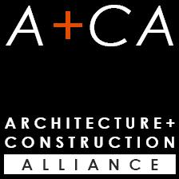
INTEGRATED DESIGN AND CONSTRUCTION SYMPOSIUM AND WORKSHOP 2017

Slide 2
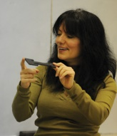
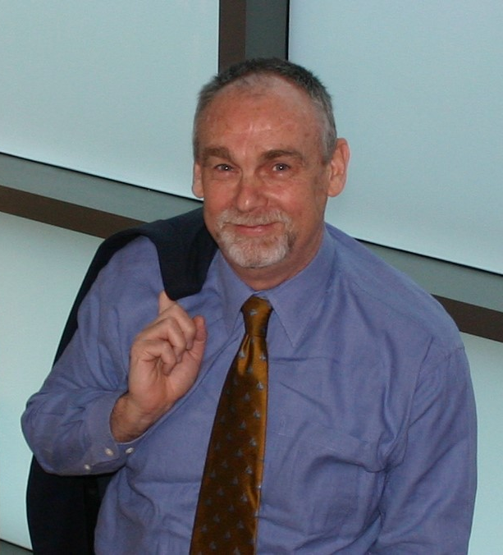
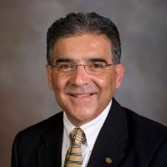
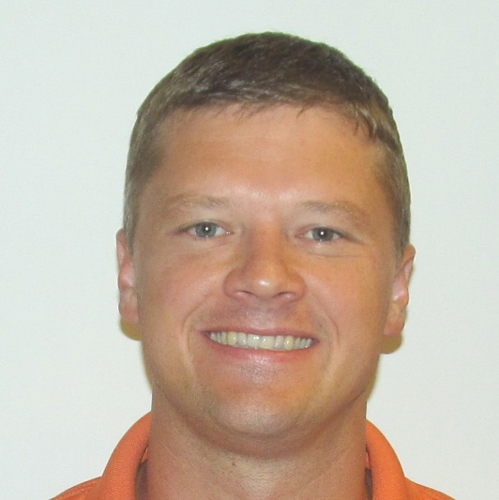
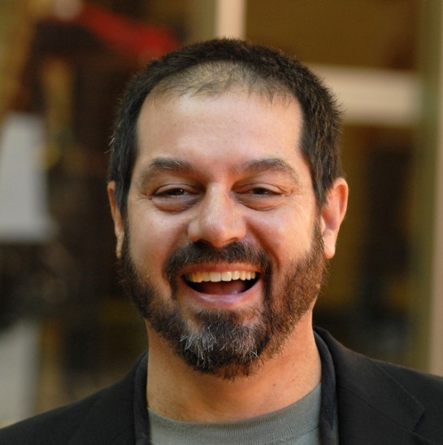
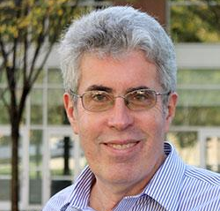
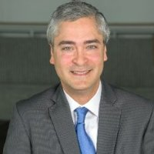
Our Team
Shima
Byron
Chema
Pardis
James
David
Craig
Javier

Slide 3
Motivation (Pardis)
Problem statement
Fragmented industry
AEC programs in academia are also operating in their individuals silos
Inefficiency and waste
Lost opportunity resulting from lack of multi-disciplinary team work
Goal
To organize an integrated design and construction symposium+research workshop
To create a strong link between industry and academia
To define research priorities and improvement to educational curriculum

Slide 4
Previous Initiatives
3/27-29, 2014, University of Washington (NSF):
Title: “Construction Engineering Conference and Workshop 2014: Setting an Industry-Academic Collaborative Research Agenda.”
Goal: to identify critical research needs; synthesizing an actionable research agenda
9/30-10/2, 2010, Virginia Tech (NSF):
“Construction engineering conference: Opportunity and vision for education, practice, and research.”
Focus areas were bridge maintenance, asset management, safety, materials management, and green construction.
Notes:
9/30-10/2, 2010, Virginia Tech (NSF):
“Construction engineering conference: Opportunity and vision for education, practice, and research.”
Focus areas were bridge maintenance, asset management, safety, materials management, and green construction. Symposium and workshop (1.5 + 0.5 days) identified opportunities in: integration for the diverse functions of modeling and simulation; create an online collaborative environment for learning; expand visual modeling and simulation of construction operations; introduce data fusion and remote sensing in courses; and apply lean concepts versus contingencies to improve sustainability.

Slide 5
Previous Initiatives
4/15-4/16, 2010. Northwestern University (NSF):
“Workshop: Driving Innovation Through Design-Engineering in the 21st Century.”
Brought together university administrators, faculty and researchers, and industrial practitioners (engineering, business, economics, journalism, arts and architecture, education and social policy)
2009, University of Illinois (NSF):
“Workshop on Key Research and Education Issues in Construction Engineering and Management for the 2010 Decade.”
A dialogue about the future of the construction industry in terms of IT research and education.
Notes:
4/15-4/16, 2010. Northwestern University (NSF):
“Workshop: Driving Innovation Through Design-Engineering in the 21st Century.”
Brought together university administrators, faculty and researchers, and industrial practitioners (engineering, business, economics, journalism, arts and architecture, education and social policy)
to hold a “substantive discussion” on the role that Design may have in helping universities achieve their mission in the twenty-first century.
2009, University of Illinois (NSF):
“Workshop on Key Research and Education Issues in Construction Engineering and Management for the 2010 Decade.”
Workshop engaged construction industry practitioners and the Information Technology and Infrastructure Systems (ITIS) academicians in a dialogue about the future of the construction industry in terms of research and education.

Slide 6
Need and Justification
The AEC industry has become specialized and fragmented, characterized by lack of trust and teamwork, disrupted workflows, and incompatible technologies
The AEC industry is attempting to self-correct through the introduction of increasingly collaborative softwares, and alternative collaborative project delivery methods
The AEC programs in academia also operate in their individual silos
Current pedagogy and course materials support behaviors that appear to perpetuate the patterns seen in the AEC industry
AEC program curriculum and research agendas need some transformation to more appropriately prepare students for the evolving industry

Slide 7
Need and Justification
Academia must provide a more reliable platform for the professions by understanding the needs and the issues facing the industry and proactively developing its research agenda and curriculum to address those needs
There is a need for constant dialogue and collaboration between industry and academia to keep these disciplines improving, ultimately leading to a more sustainable industry
The need for research on integrated design and construction has been well documented in the literature over the years (Egan, 1998; Latham, 1994; Koskela and Howell, 2008; Koskela, 2000; Ghassemi and Becerik-Gerber, 2011; O’Connor, 2009)
Howell et al. (2004) suggested a need for a comprehensive paradigm shift in the construction industry

Slide 8
Need and Justification
This symposium and workshop will establish common ground and identify overlapping priorities between the industry and academia
The analysis of these priorities will allow participants on both sides to determine opportunities for systemic added value and cost savings, and to promote improved quality of design and construction.
This partnership will have a two-fold outcome:
the expansion of industry-supported research capacity and industry-relevant research deliverables, and
a positive long-term impact on the education of students incorporating the increasing need for collaborative working models in their future professions

Slide 9
General Methodology
Location
Georgia Institute of Technology, Atlanta Georgia
Caddell Flex Space in the School of Building Construction
Date
October 12 to 13, 2017
Proposed chair and organizing committee
Dr. Jesús M. de la Garza, Virginia Tech, Symposium Chair
Dr. Shima Clarke, Clemson University, Proceedings Editor
Dr. Pardis Pishdad, Georgia Tech, Organizer and PI

Slide 10
General Methodology
Proposed chair and organizing committee
Dr. Craig Zimring, Georgia Tech, Organizer
Dr. Javier Irizarry, Georgia Tech, Organizer
Dr. James Smith, Clemson University, Organizer
Prof. David Alison, Clemson University, Organizer
Prof. Byron Edwards, Clemson University, Organizer
Additional team members
Dr. Daniel Castro, Chair, School of Building Construction, Georgia Tech
Scott Marble, Chair, School of Architecture, Georgia Tech

Slide 11
Research Objectives (Chema)
This intertwining of a symposium and workshop provides a unique venue that brings together a focused group of AEC practitioners and university educators/researchers to discuss the challenges facing today’s AEC professional workforce as well as the opportunities to achieve a more integrated architecture, engineering, and construction workflow process.
Universities produce graduates; Industry hires them
The ebb and flow of work creates a significant challenge for the AEC industry to attract and keep talented and experienced professionals
Efficiency gains can be achieved by eliminating hand-offs between architecture, engineering, and construction functions through technology

Slide 12
Research Objectives (Chema)
The goals of this symposium/workshop event are twofold:
first, to stimulate a synergistic discussion around the interfaces between industry practitioners (the consumers of graduates) and construction educators/researchers (the producers of graduates); and
second, to establish a holistic research and curriculum development agenda to support the AEC needs of the 21st century
Several research workshops conducted since the mid 1970’s have explored the broader aspects of construction engineering and management
none has explicitly focused on professional workforce and design/construction integration issues;
none to our knowledge has sought to holistically integrate issues as viewed by construction practitioners with engineering educators/researchers

Slide 13
Research Objectives (Chema)
There exists limited interactions between industry practitioners and academic scholars, who live in culturally very different environments, yet share a dedication to and common interests of the AEC industry
The goal of the symposium is
to investigate the entry-level professional competencies desired for an industry that is more integrated in the 21st Century, and
to identify and investigate the curricular pressures faced by universities
The goal of the workshop is
to introduce faculty and industry practitioners to the opportunities in AEC education and research, and
to establish priorities

Slide 14
Proposed Symposium and Workshop
Specific Questions or Topics to be Addressed
The symposium/workshop will target four key research initiatives:
(1) trust and collaboration in the AEC industry as an overall objective,
(2) through an integrated project delivery process,
(3) employing building information modeling as a collaborative tool, and
(4) healthcare facility design and construction as an ideal market sector that can both benefit and inform integrated solutions

Slide 15
Proposed Symposium and Workshop
Proposed Schedule
Proposed Dates: October 12-13, 2017
Venue: Georgia Tech Campus, Atlanta, Georgia
Day 1 (Thursday, October 12); Symposium
8:00-8:45 AM Registration and Coffee
8:45-9:00 AM Welcome and Introduction
9:00-10:30 AM Keynote Speech: Building Trust Through Integrated Project Delivery [owners perspective]
10:30-10:45 AM Break
10:45-11:30 AM Session 1-A: Academic Presentation: Symbiotic Relationships between IPD and Trust Building Traits.
11:30-12:15 PM Session 1-B: Industry Presentation: IPD in Practice
12:15-1:30 PM Lunch
1:30-3:00 PM Session 2: National or International IPD Best Practice Case Study Project (to be determined)
3:00-3:15 PM Break
3:15-4:45 PM Panel Presentation and Discussion: Opportunities and Barriers to IPD Process
4:45-5:00 PM Closing Comments
6:30-9:00 PM Reception and informal interaction

Slide 16
Proposed Symposium and Workshop
Day 2 (Friday, October 13): Workshops [with NSF funding]
9:30-10:00 AM Workshop Kickoff
10:00-12:00 PM Breakout Working Sessions (tbc)
Session 1: Integrating Trust-Building Tools into Academia
Session 2: Collaboration between Disciplines – eliminating the SILOS
Session 3: Eliminating the Barriers and Maximizing the Opportunities
Session 4: Academia into Practice and Practice into Academia
Session 5: Research to Practice
Session 6: Chair/Deans’ Discussions on Curriculum Changes
12:00-1:30 PM Lunch
1:30-3:00 PM Breakouts Report
3:00-4:00 PM Closing Summary Discussion

Slide 17
Proposed Symposium and Workshop
Proposed Participants and Method of Selection
The future success of the AEC Industry hinges upon a synergistic and collaborative dialogue with Academia - as Research and Education in this arena needs a balance of both academic rigor and real-world industry insights for both current and future faculty and practitioners.
Method of selection is to use the targeted diversity of the conference program and the selected speakers and panelists to appeal to all key participants, in order to get a good workable balance between industry stakeholders and academic researchers and educators for a more collaborative and useful dialogue
Academics with authoritative positions to make changes to the educational curriculum, including deans and school chairs of both Architecture and Construction programs will be invited and encouraged to attend the event.

Slide 18
Proposed Symposium and Workshop
Advertisement of Symposium and Workshop and Participant Invitation
The event will be advertised with several professional and academic organizations and their websites to solicit healthcare owners/clients, architectural, engineering, and construction participants for this symposium and its companion workshop from both Industry and Academic organizations and/or associations
Dissemination of Symposium and Workshop Results
The dissemination of the symposium presentations and panel discussion will be by advertised online access to PowerPoint presentations and possibly videos
Dissemination of the Workshop Sessions will include recorded notes along with publication and distribution of associated research and whitepapers presented, along with post-workshop evaluation forms and responses.

Slide 19
Intellectual Merit & Broader Impact
Intellectual Merit
Collectively defining the research priorities and opportunities for integrated design and construction
Strategically designing the future of AEC education curriculum, reinforcing integration
Broader Impact
Making the industry more efficient and less wasteful by promoting integration
Enabling and enhancing quality of life
Improving national economy

Slide 20
Go/no go Scenarios & Questions
Next Steps:
Proposal submission to NSF to fund participant attendance to Friday workshop
NSF decision could take up to 6 months if put through panel review
If NSF Program Director decides to review internally, decision could be made sooner (we may not know this unless PD contacts us)
GO/NO GO Decision:
If NSF funds proposal, it would be a clear GO.
If NSF does not fund proposal, would A+CA still wish to have the symposium and provide support for it.

Slide 21
Georgia Tech Virginia Tech Clemson
Thank You!

